Slide 1
Construct 2
Endless Possibilities

Slide 2
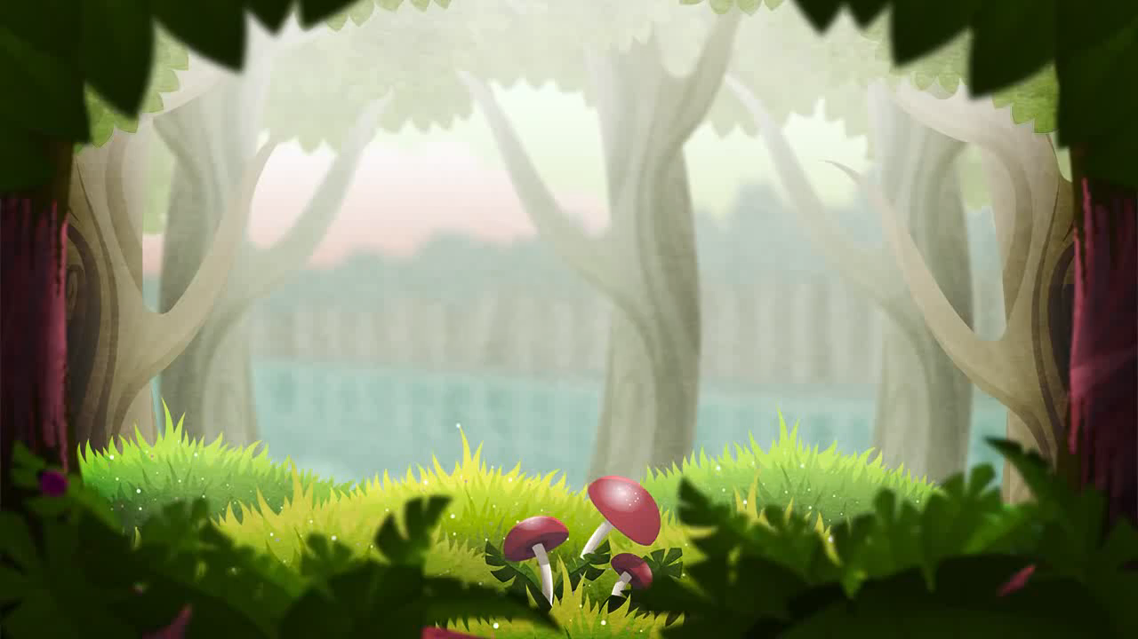
Mortar Melon – Windows Store & Wii U
1,000,000 +
downloads
$400,000 +
yearly
Most Popular Construct 2 Game

Slide 3

Beast Attack – Google Play Store
200,000 +
downloads
$75,000 +
yearly
4.3/5
2k+ reviews

Slide 4
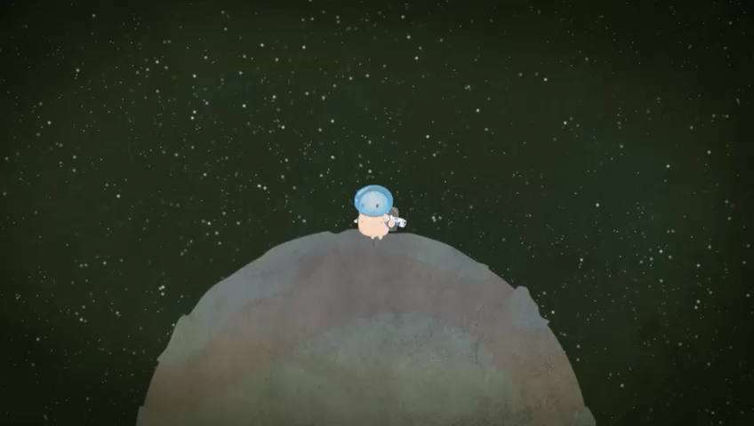
Cosmochoria – Steam Store
22,000 +
owners
$200,000+
93% positive
350+ reviews

Slide 5
Your Game – Any Platform
?
The Adventures of Lumo
Contrast
Your Game

Slide 6
Considerations
Build an Atmosphere
Game
Up the Ante
Juice it Up

Slide 7
Considerations
Know Your Market
Social
Connect Your Users
Keep Them Coming Back

Slide 8
Considerations
Give a Sample
Money
Price it Fair
Know the Platform

